Slide 1
Suspicious person detector software
By : Nantres and Boon Chuan

Slide 2
Summary of ideas
The project
Data gathering
Data preparation
Chosen model
Evaluation
Deployment

Slide 3
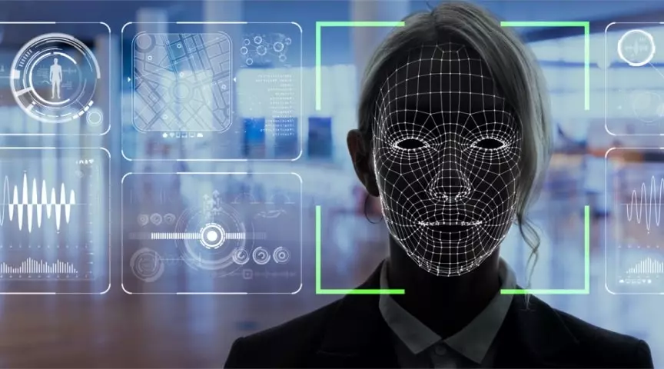
The project
Our project is to create a machine learning model (MLM) to identify suspicious behaviour for security purposes
The rationale is that by using this MLM, we can apprehend those with malicious intent before any harm is done.

Slide 4

Data gathering.
To gather the data, we went on Roboflow, where we found a image dataset called ‘human gesture for surveillance Dataset’ created by the Indian Institute of Technology Madras.
We also supplemented this dataset with images from the web, and some of our own images
Faces form a part of the images and act as an indicator of suspicious behaviour
Very Suspicious face

Slide 5
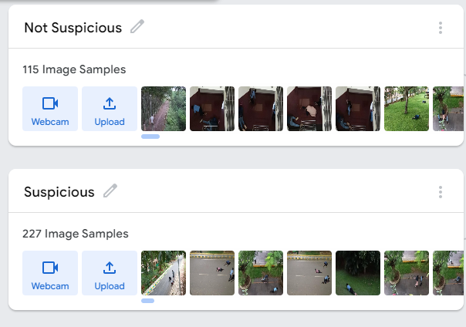
Data Preparation
First, we had to split the data into the ‘Suspicious’ and ‘ Not Suspicious’ categories

Slide 6
Model Chosen
The machine learning model we have chosen to use is Teachable Machine with Google
We chose this model due to its ease of use.

Slide 7
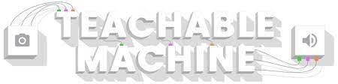
Model Chosen
The machine learning model we have chosen to use is Teachable Machine with Google
We chose this model due to its ease of use.

Slide 8
Evaluation
The Model is relatively accurate in differentiating suspicious threats, as seen in the next slides.
The model correctly identifies suspicious behaviour most of the time, but there are times where it fails to do so
The reason for this would be that not enough data was used to train the model

Slide 9
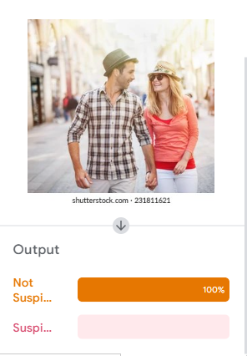
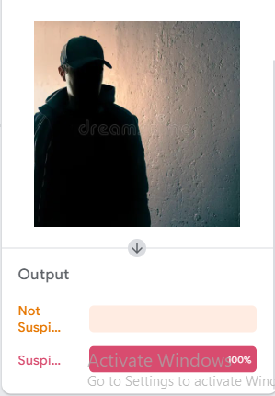
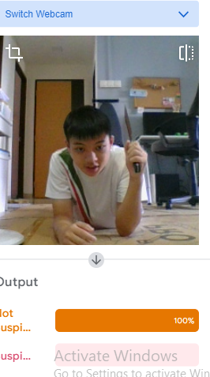
Non-Suspicious looking faces
Suspicious looking face

Slide 10

Deployment
This model can be inserted into Pictoblox to create a more refined, user-friendly product.
This will make the model more convenient to use, which would be attractive to potential clients.

Slide 11
Thank You

